Slide 1

OBJECT RECOGNITION SYSTEM

Slide 2

Infosys Springboard Internship Assessment Object Recognition System
Presented by:
Vrunda Bramhe
Lakshya Jindal
Irene Maria Thomas
Senthil Kumar
Guided by:
Anil Shaw
Springboard Mentor

Slide 3
Object Recognition System
Model Selection and Training
Model Comparison for Object Detection
System Architecture
Technology Stack
Working of Object Detection System
7. Project Snapshot
8. Real-World Applications
Contents

Slide 4
What is an Object Recognition System? An Object Recognition System (ORS) is a technology that identifies and classifies objects within images or videos using machine learning and computer vision techniques.
Key Processes :
Object Detection
Image Classification
Assigning a label or category to an entire image, indicating the dominant object or scene depicted.
Instance Segmentation
Precisely defining the boundaries of each instance of an object within an image, creating pixel-level masks for each identified object.
Locating and identifying specific objects in an image, often by drawing bounding boxes around them.

Slide 5
Model Selection and Training
Model Choice
Parameter Optimization
Model Validation
Evaluate options like Faster R-CNN , Mask R-CNN , YOLOv5.
Optimize parameters such as learning rate, batch size, and epochs.
Assess model performance using the validation dataset.
1
2
3
4
5
6
Divide the dataset into training, validation, and testing sets.
Initiate training for selected models using
the training data.
Use the test dataset to evaluate the final model accuracy.
Dataset Split
Model Training
Test Performance

Slide 6
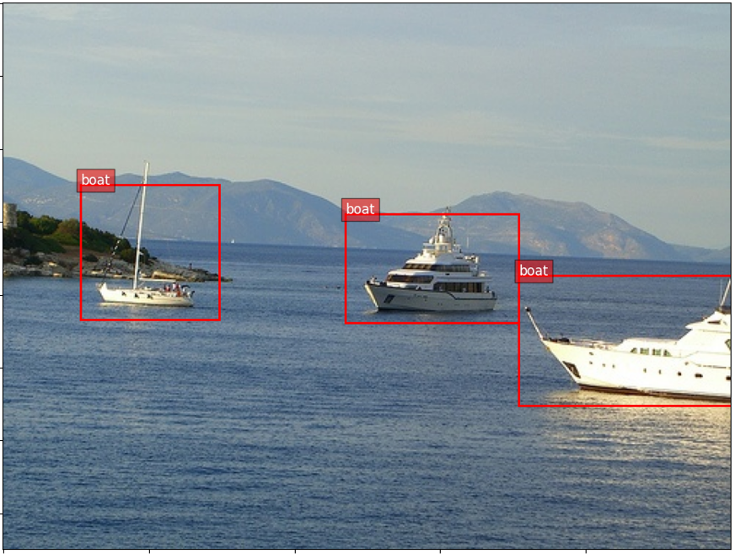
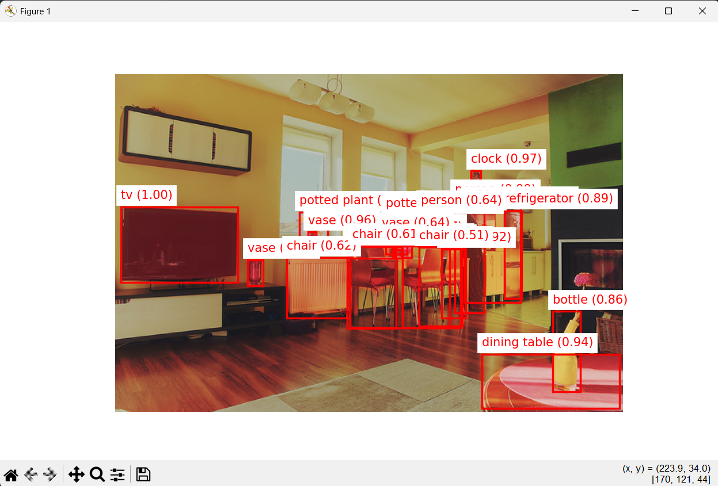
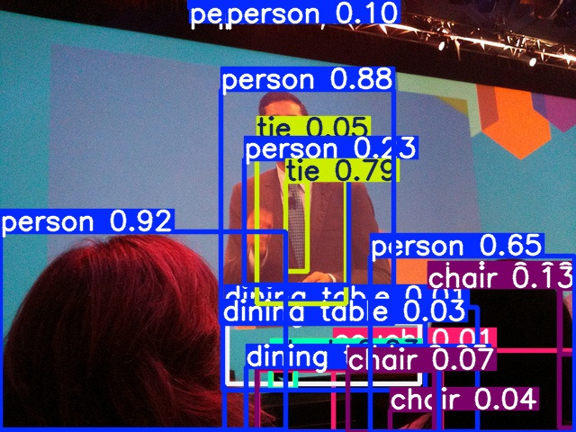
Model Comparison for Object Detection
Faster R-CNN
Region-based CNN for object detection using Region Proposal and classification.
Strengths: High accuracy in object localization and classification.
Rejection Reason: Slow inference made it unsuitable for real-time applications.
Mask R-CNN
Adds segmentation to Faster R-CNN.
Strengths: Detection + segmentation.
Rejection Reason: High computational cost hindered performance in large-scale tasks.
YOLOv5
Fast real-time detection.
Strengths: High speed and accuracy.
Selection Reason: Chosen for its real-time speed, high accuracy, and efficiency in handling both small and large objects.

Slide 7
System Architecture
1. Data Preprocessing
Resizing, normalizing, and augmenting images for effective training.
2. Model Training
Implementing YOLOv5 for object recognition and OpenCV for live video detection.
3. Inference Pipeline
Processing input images through trained models to generate predictions.
4. Post-Processing
Extracting bounding boxes and confidence scores from the model output.
5. Flask Interface
Developing a web interface for user interaction with the system.
6. Deployment Setup
Ensuring accessibility and responsiveness for end users.

Slide 8






Technology Stack
PyTorch
YOLOv5
OpenCV
Used to load and run the YOLOv5 model for object detection. It’s crucial for model inference and fine-tuning in deep learning tasks.
An efficient object detection model used for real-time recognition in images and videos. It’s important for fast and accurate object detection.
Handles image and video processing, such as reading frames and displaying results. It’s essential for real-time video manipulation.
Streamlit
PIL (Python Imaging Library)
CUDA & NVIDIA GPU
A tool for building interactive web apps that lets users upload images, view detections, and download results.
Used to accelerate deep learning computations for faster inference, essential for real-time processing in object detection.
Manages image formats and conversions between NumPy arrays and image formats. Important for preparing images for detection.

Slide 9
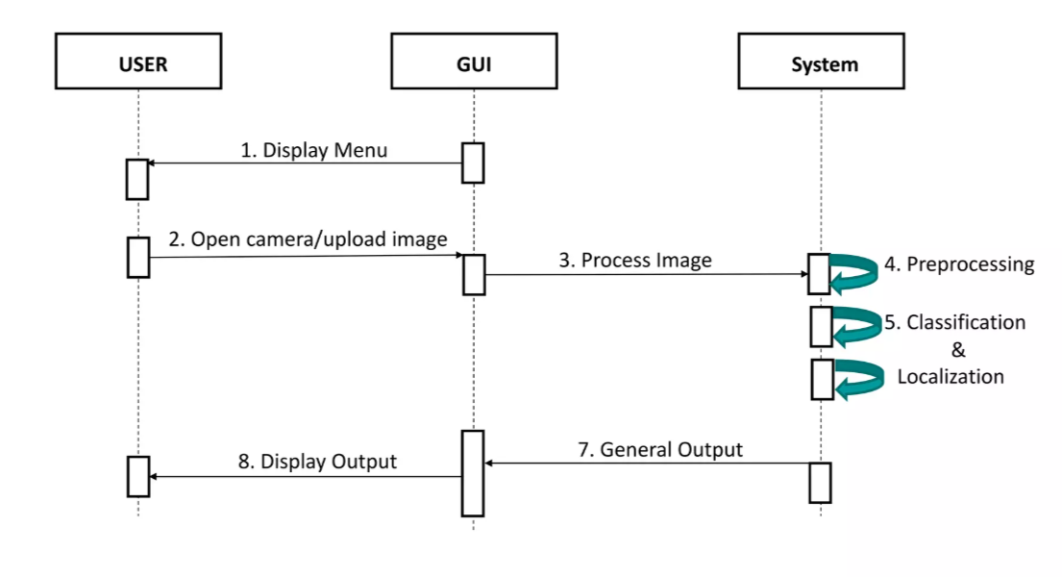
Working of Object Detection System

Slide 10
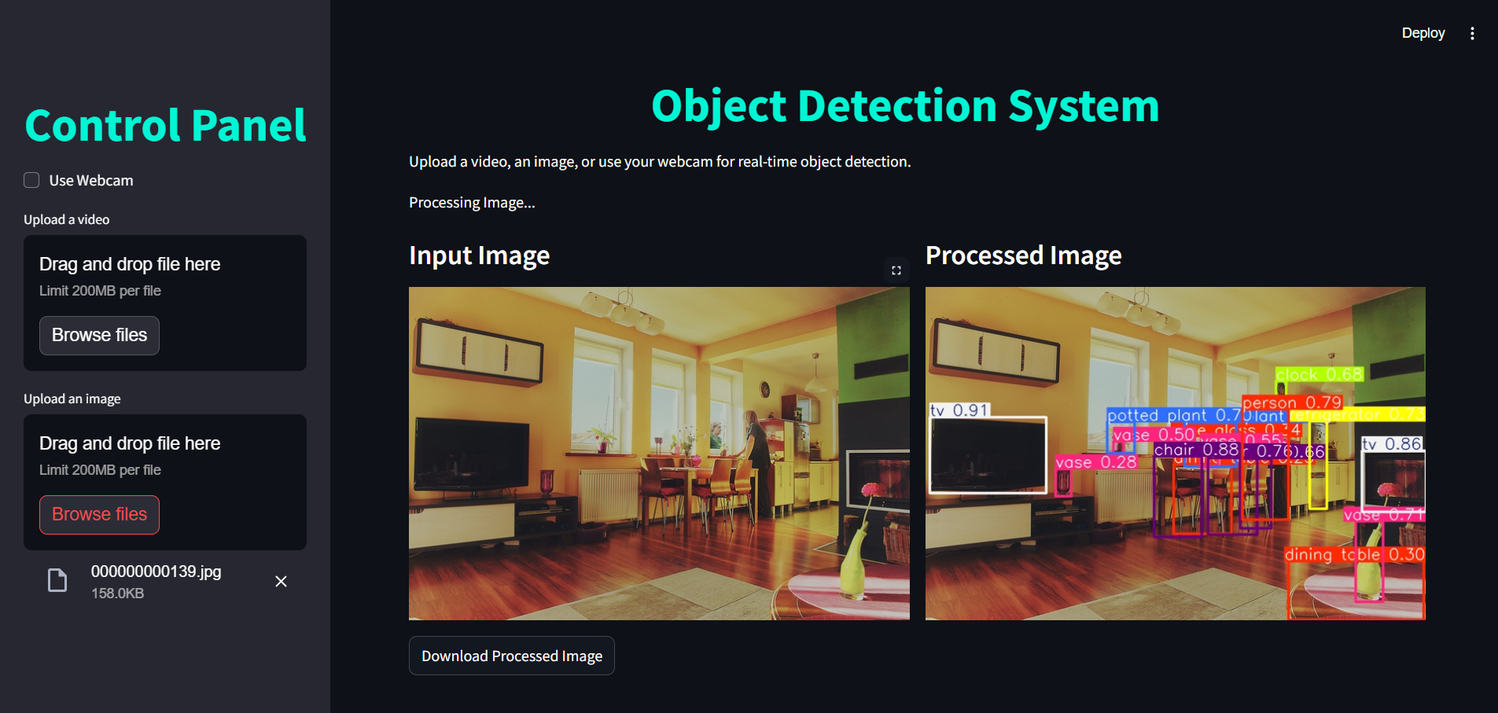
Object Recognition System Outcome

Slide 11
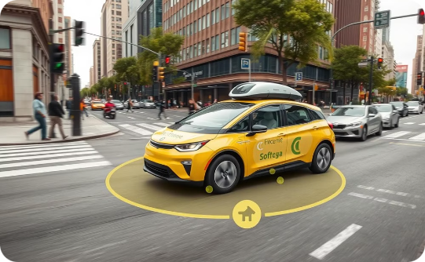
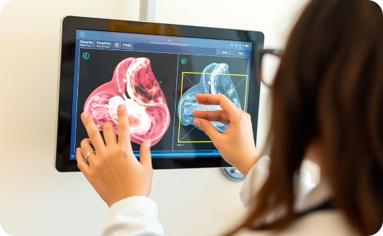
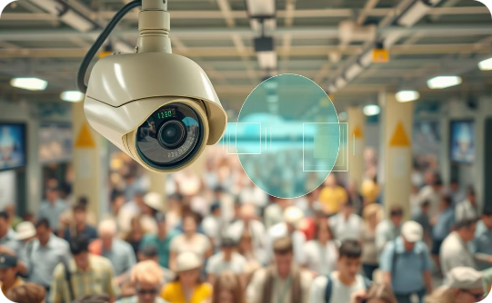
Real-World Applications
Autonomous Driving
Medical Imaging
Security
ORS are crucial for autonomous vehicles, enabling them to perceive their surroundings and make safe driving decisions.
ORS can assist doctors in diagnosing diseases by automatically detecting and classifying abnormalities in medical images like X-rays, MRIs, and CT scans.
ORS are used in security systems for facial recognition, intrusion detection, and anomaly detection, enhancing safety and security in public spaces.

Slide 12


